Slide 1
Dogs of Zurich
By Giovanni Hermosillo

Slide 2
Situation
A pet grooming store in Zurich, Switzerland wants to expand and open up a new branch store.
Where?
Specializations?

Slide 3
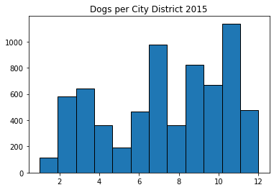

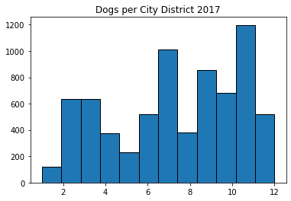
Dogs per District

Slide 4
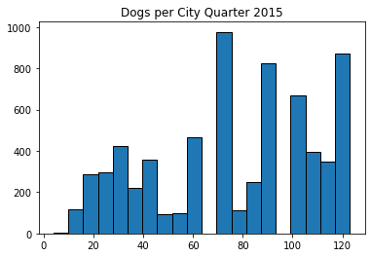
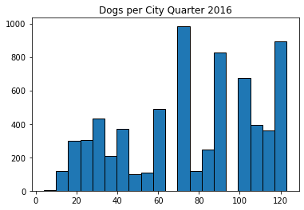
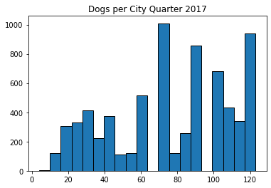
Dogs per Quarter

Slide 5
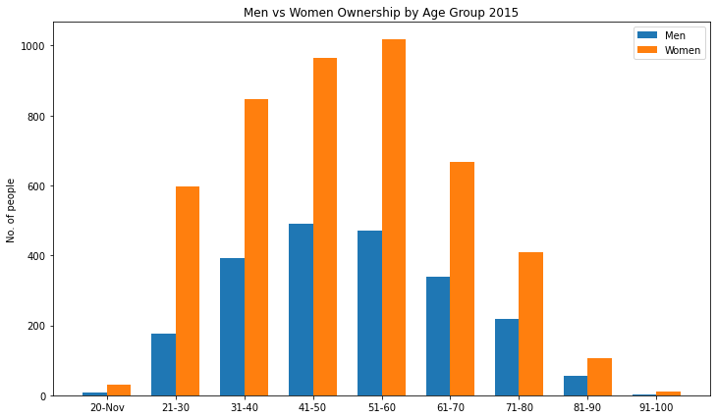
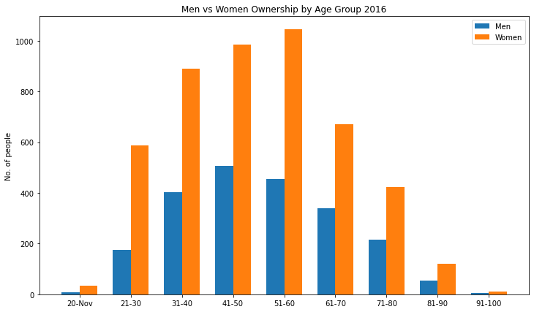
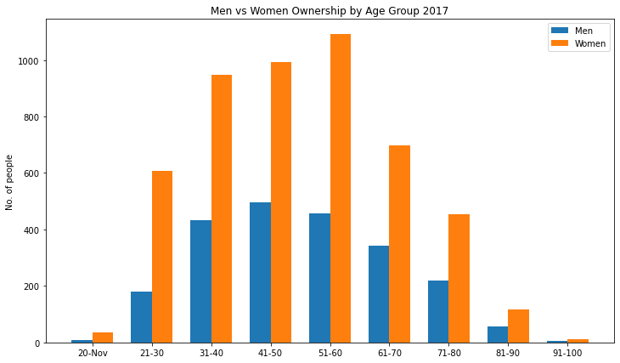
Men vs. Women Ownership

Slide 6
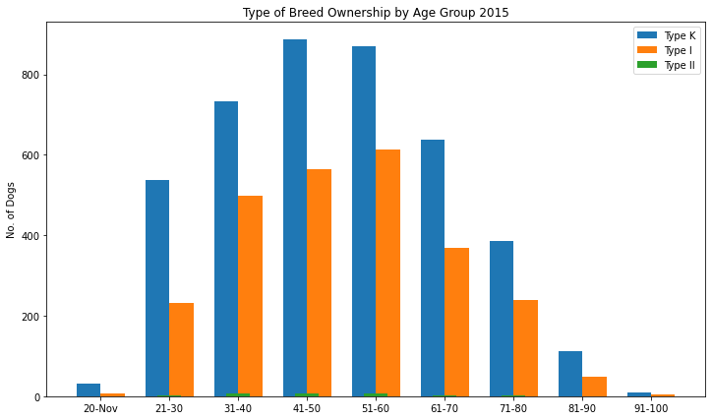
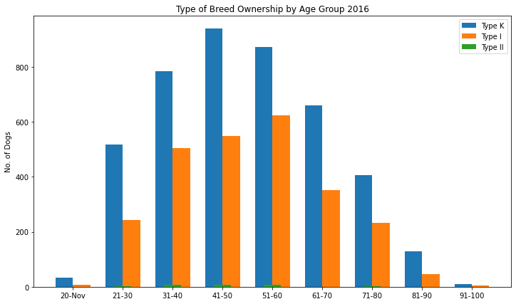
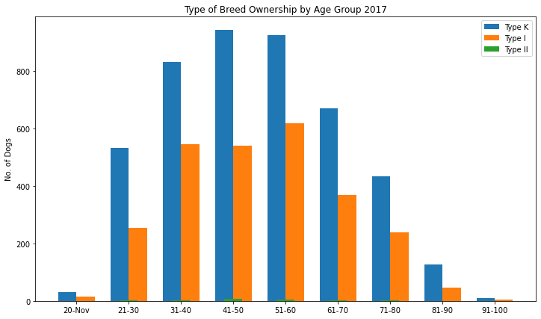
Breed Ownership by Age Group

Slide 7
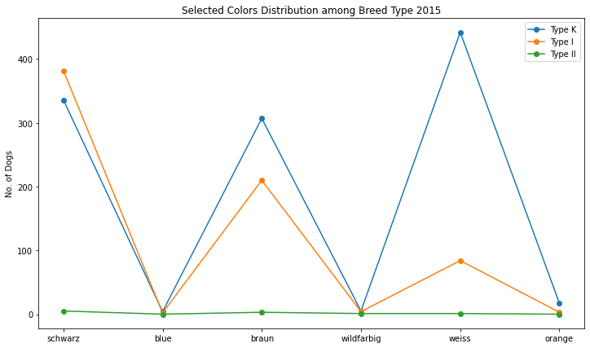
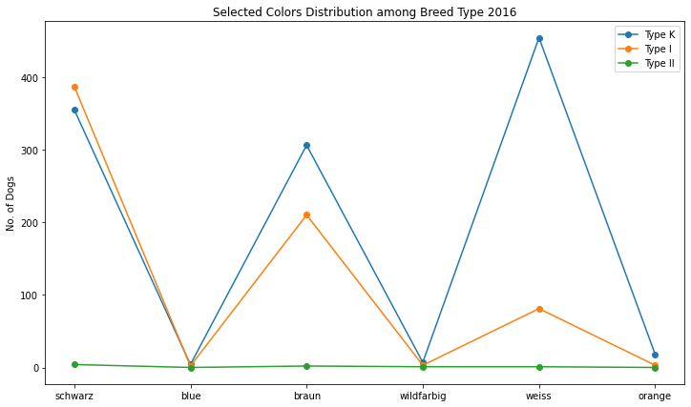
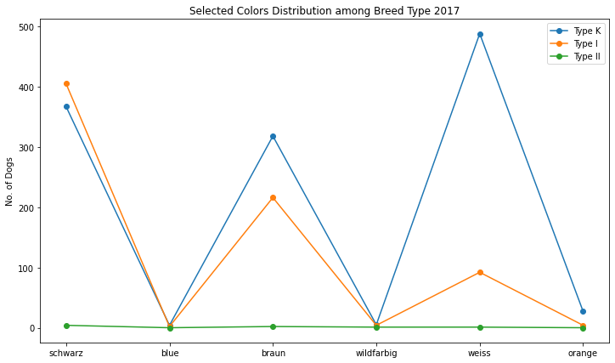
Dogs’ Hair Color by Breed Type

Slide 8
Recommendations
Location: District 7 or 11
Specializations:
Specialize in Type I & K breeds. Type II breeds will cost extra.
Dog Hair Colors: Schwarz, Weiss, Braun

